Slide 1

A
PRESENTATION ON
“TIME MANAGEMENT”
Submitted in the partial fulfillment of the award 0f
Bachelor of Technology
(Rajasthan Technical University, Kota)
Session 2021-22
Guided By :
Ms. Shalini Shah
Submitted By:
Gagan Sharma PCE/CS/064 2 Year, 4 Semester
DEPARTMENT OF SECOND YEAR
POORNIMA COLLEGE OF ENGINEERING

Slide 2

INTRODUCTION
It is right said “Time and tide wait for none”.
An individual should understand the value of time for him to succeed in all aspects of life.
People who waste time are the ones who fail to create an identity of their own.

Slide 3
What is Time Management?
Time management refers to--
Managing time effectively, so that the right time is allocated to the right activity.
Making the best use of time, as time is always limited.

Slide 4
Continue….
Effective time management allows individuals to assign specific time to activities as per their importance.
Ask yourself “which activity is more important? How much time should be allocated to?”
Know which work should be done earlier and which can be done a little later.
Time Management plays a very important role, not only in organizations, but also in our personal lives.

Slide 5
Time Management includes:
Effective Planning
Setting goals and objectives
Setting deadlines
Delegation of responsibilities
Prioritizing activities as per their importance
Spending the right time on the right activity

Slide 6
Effective Planning
Plan your day well in advance.
- Prepare a To DO List or a “TASK PLAN”.
- Order activities according to their priority.
- Allocate suitable time to each activity.
Complete pending tasks one by one.
- Do not begin fresh work unless you have finished your previous task.
Tick the ones you have already completed.
Ensure you finish tasks with in the stipulated time frame.

Slide 7
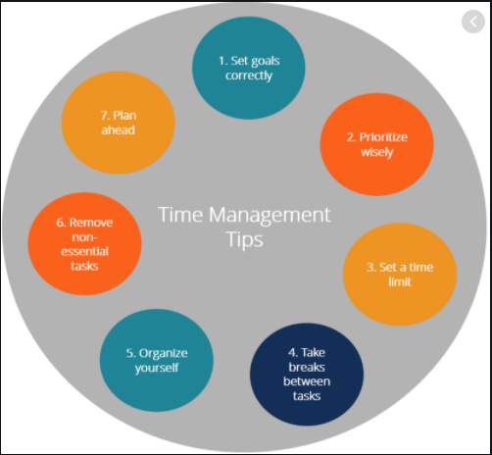

Slide 8
Setting Goals and Objectives
Working without goals and targets in an organization would be similar to a situation where the captain of the ship loses his way in the sea.
Set targets for yourself and make sure they are realistic and achievable.

Slide 9
Setting Deadlines
Ask yourself “how much time needs to be devoted to a particular task?”
Set deadlines for every task, and be committed to.
Do not wait for your superiors to ask you every time.
Learn to be self driven.

Slide 10
Delegation of Responsibilities
Don’t do everything on your own , there are other people as well.
Roles and responsibilities should be delegated to employees according to their interest and specialization to ensure they would finish within deadlines.
An employee who does not have enough knowledge needs more time than someone who knows the work well.

Slide 11
Prioritizing Tasks
Prioritize task as per their importance and urgency.
Know the difference between important and urgent work.
Identify which tasks should be done along the day, and during the month.

Slide 12
Spending the Right Time on Right Activity
Develop the habit of doing the right thing at the right time.
Work done at the wrong time is not of much use.
Keep some time separate for your personal calls or checking updates on Whatsapp or Facebook or Twitter.
Afterall, human being is not a machine.

Slide 13
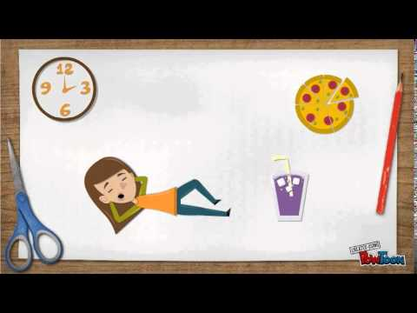

Slide 14
Characters of Good Time Manager:
Organized
Avoid keeping stacks of file and heaps of paper at your workstation.
Throw what all you don’t need.
Put important documents in folders.
Keep the files in their respective drawers with labels on top of each file.
It saves time which goes on unnecessary searching.

Slide 15
Don’t misuse time
Concentrate and finish assignment on time.
Don’t wait till the last moment.
Do not kill time by loitering or gossiping around.
Remember your organization is not paying you for playing games on computers or peeping into other’s cubicles.
First complete your work and then do whatever you feel like doing.

Slide 16
Be Focused
Develop the habit of using planners, organizers, tables calendars for better time management.
Set reminders on phones or your PC.

Slide 17
Benefits of Time Management
Time Management refers to make the best possible use of available time.
Managing time well enables an individuals to do the right thing at the right time.
Time management plays a pivotal role in one’s personal as well as professional life.
Let us go through some benefits of Time Management.

Slide 18
Thank you

